Slide 1
Capstone 2 Presentation
by
Chew Chien Zhen
19037746

Slide 2
An Artificial Intelligence Model for Flood Prediction in Urban Areas Based on Swarm Intelligence Algorithms and Artificial Neural Network

Slide 3
An Artificial Intelligence Model for Flood Prediction in Urban Areas Based on Swarm Intelligence Algorithms and Artificial Neural Network
Scope of the project
Supervised learning technique
Kerala state study area
Using one dataset. A labelled dataset of Kerala flood from the year 1901 to the year 2018
Accuracy evaluation
Future vision (remaster)

Slide 4
An Artificial Intelligence Model for Flood Prediction in Urban Areas Based on Swarm Intelligence Algorithms and Artificial Neural Network
There are 3 models in this project:
Benchmark 5 machine learning algorithms model
Feedforward Neural Network model
Particle Swarm Optimization in Training Artificial Neural Network model

Slide 5
The Kerala flood dataset
It is a labelled dataset
Dataset already has pre-determined outcomes of flood occurrences
The outcomes are labelled in the form of YES and NO
Consist of monthly rainfall data and an annual rainfall as the total amount of rainfall on that year

Slide 6
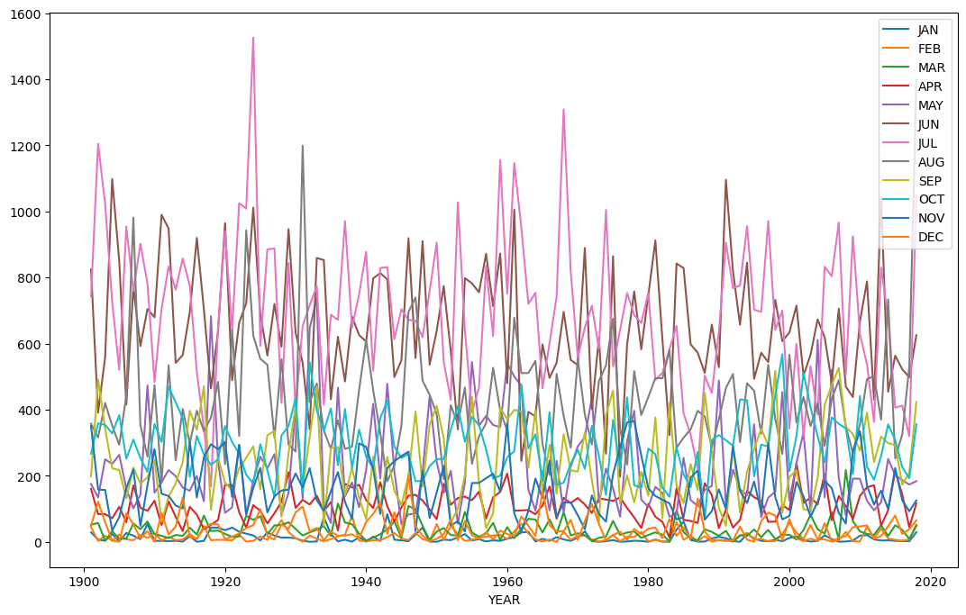
The Kerala flood dataset
Visual graph of the Kerala dataset (in terms of monthly rainfall and the corresponding year)

Slide 7
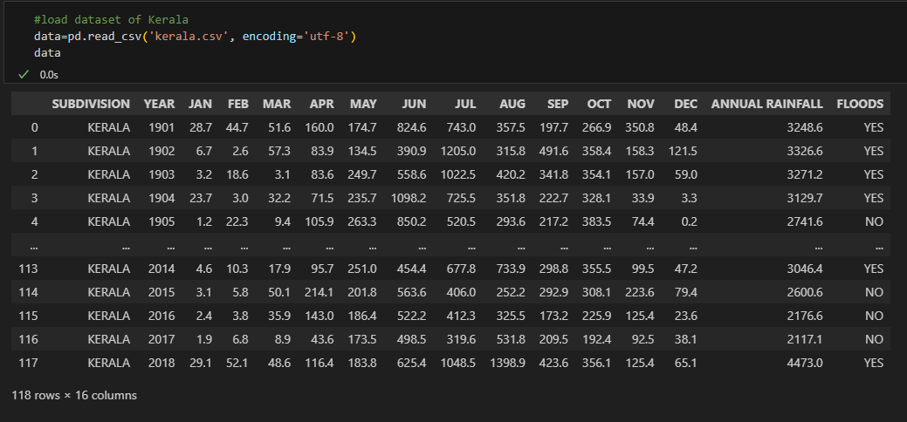
The Kerala flood dataset
What the Kerala flood dataset looks like.
How many rows and columns the dataset has.

Slide 8
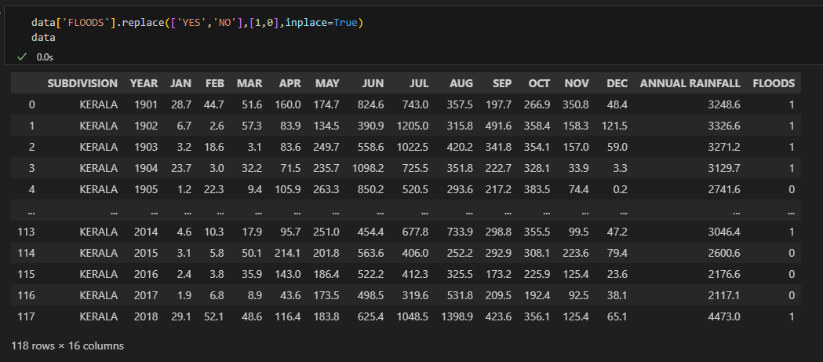
The Kerala flood dataset
Replace the YES and NO label to 1 and 0 respectively.
This conversion is done in all the models in this project.

Slide 9
The Kerala flood dataset
Reason for this conversion?
The FLOODS column will be the target value for all the models
The target value is used to evaluate the accuracy of the models
(comparison of predicted values and target values)

Slide 10
Benchmark 5 machine learning algorithms model

Slide 11
Benchmark 5 machine learning algorithms model
Usage of SkLearn (also known as scikit-learn)
Machine Learning algorithms from sklearn used in this model:
K-Nearest Neighbour (KNN)
Support Vectors Classification (SVC)
Logistic Regression (LOG)
Decision Tree Classifier (DT_CLF)
Random Forest Classifier (RF_CLF)

Slide 12

Benchmark 5 machine learning algorithms model
Usage of SkLearn (also known as scikit-learn)
With Sklearn, split the data to Test data and Training data to be used for prediction and accuracy calculation by the algorithms later.

Slide 13
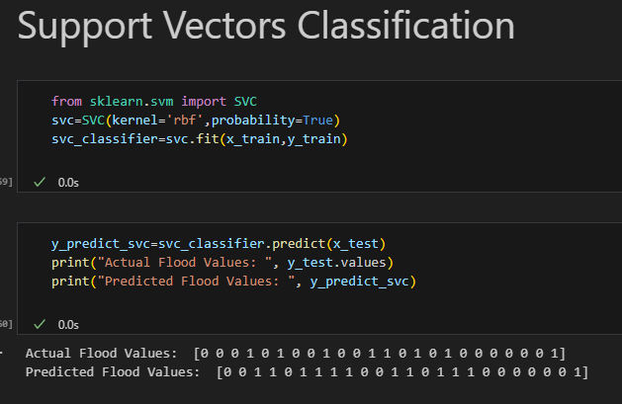
Benchmark 5 machine learning algorithms model
Through sklearn, import the supervised machine learning algorithm to be used for the prediction and accuracy evaluation with the Kerala flood dataset.

Slide 14
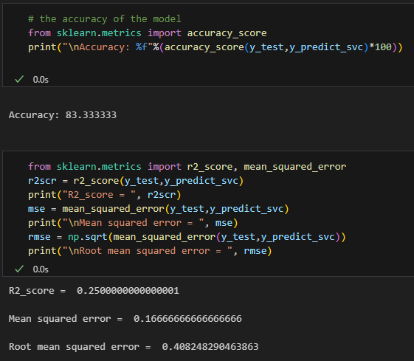
Benchmark 5 machine learning algorithms model
Calculating the Accuracy, the Mean squared error (MSE) and Root mean square error (RMSE) of the algorithm.

Slide 15
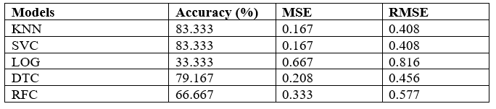
Benchmark 5 machine learning algorithms model
The steps were repeated with the SVC, LOG, DT_CLF, and RF_CLF algorithm. The results are shown in a table below.

Slide 16
Benchmark 5 machine learning algorithms model
Purpose of this model
Just like its name stated. This model will be used as a benchmark in terms of evaluation of accuracy when performing a prediction on a labelled dataset.

Slide 17
Feedforward Neural Network model

Slide 18
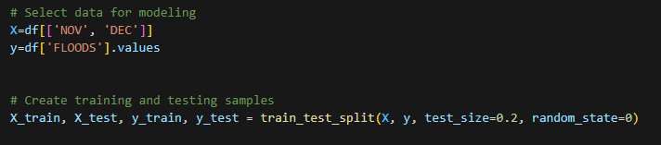
Feedforward Neural Network model
Breakdown of the model
First, data preparation for the input feature and the target value labelled “x” and “y” respectively and data is split into training and testing sets. (80% training data, 20% test data)

Slide 19
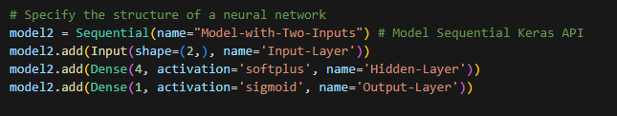
Feedforward Neural Network model
Breakdown of the model
Second, The structure of the neural network is defined using Keras Sequential API.

Slide 20
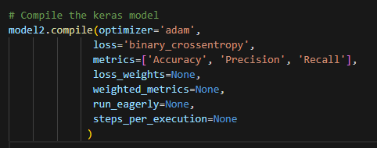
Feedforward Neural Network model
Breakdown of the model
Third, compile the model with the parameters involving the Adam optimizer, the Binary Cross-entropy, and metrics(accuracy, precision and recall)

Slide 21
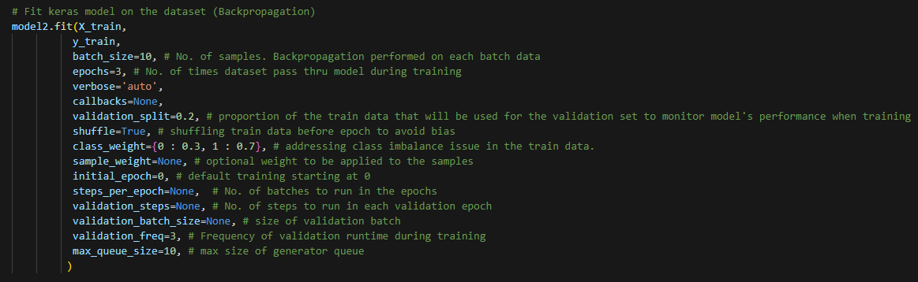
Feedforward Neural Network model
Breakdown of the model
Forth, train the model using backpropagation

Slide 22
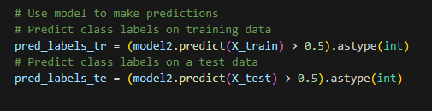
Feedforward Neural Network model
Breakdown of the model
Fifth, make predictions after the model has undergone training

Slide 23
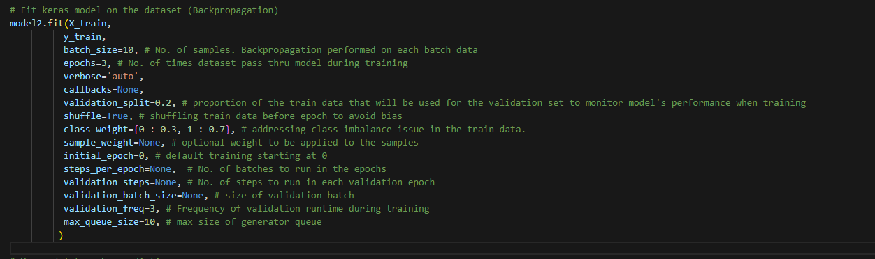
Feedforward Neural Network model
Usage of the Backpropagation process.
Fit method performs the training process with the backpropagation process to optimize the model’s weight while referring to the loss function(binary cross-entropy) and the training data.
After the training process, the model can be used to make predictions

Slide 24
Feedforward Neural Network model
Inconsistency in output data
The accuracy of the output from the model varies from 0% to 55.319%. Due to such inconsistency, the model was run several times to find out the highest possible accuracy % the model can reach.
The following are the outputs after several runs.
It is observed that the highest possible accuracy the model can achieve is 55.319%

Slide 25
Feedforward Neural Network model
Purpose of this model
This model is an experimental procedure to observe the prediction results of a neural network that is not trained by a Swarm Intelligence Algorithms.
This model will be used in the evaluation and comparisons of accuracy with a neural network model that is trained by a swarm intelligence algorithm.

Slide 26
Particle Swarm Optimization in training Artificial Neural Network model

Slide 27
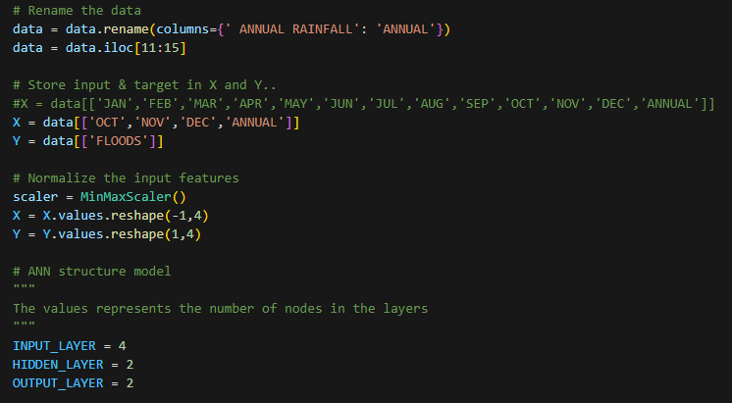
Particle Swarm Optimization in training Artificial Neural Network
Breakdown of the model
First, label the input feature and the target value with “x” and “y” respectively and then normalize the input feature for better convergence. Then, define the ANN structure.
With the usage of the `data.iloc` function, the input data can be controlled via the columns.

Slide 28
Particle Swarm Optimization in training Artificial Neural Network
Breakdown of the model
Second, compile the Particle class, Swarm class, optimize function, and get_best_solution function to perform optimization and get the best solution found in the PSO algorithm.
Particle class to assign random positions, velocity, personal best values, and personal best positions
Swarm class to create particles, start global best values and store information for optimization
Optimize function to evaluate particle fitness, velocities, personal and global best positions.
Get_best_solution to obtain best solution in the PSO

Slide 29
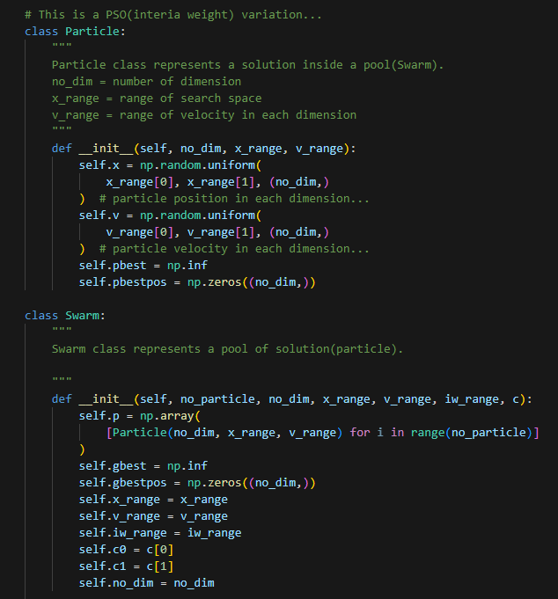

Slide 30
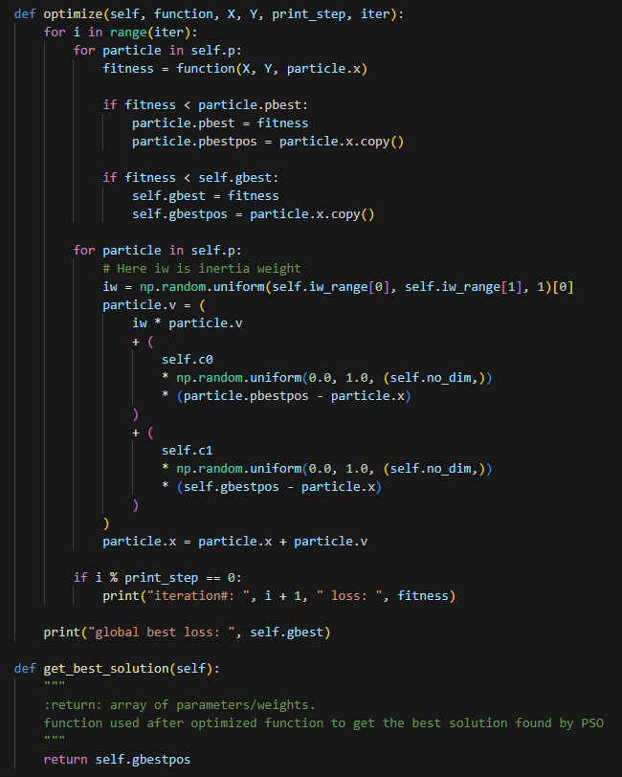

Slide 31
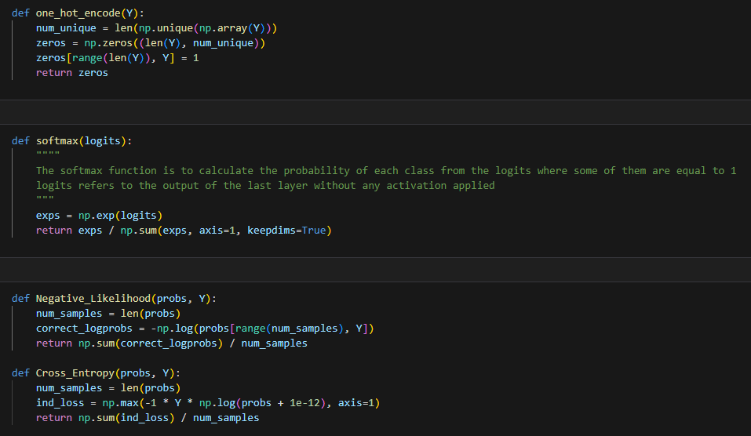
Particle Swarm Optimization in training Artificial Neural Network
Breakdown of the model
Third, compile the one_hot_encode, softmax, Negative_Likelihood, and Cross_Entropy functions
Softmax to get the class probabilities, while negative_likelihood or cross_entropy to calculate loss between predicted probabilities and true class labels when training.

Slide 32
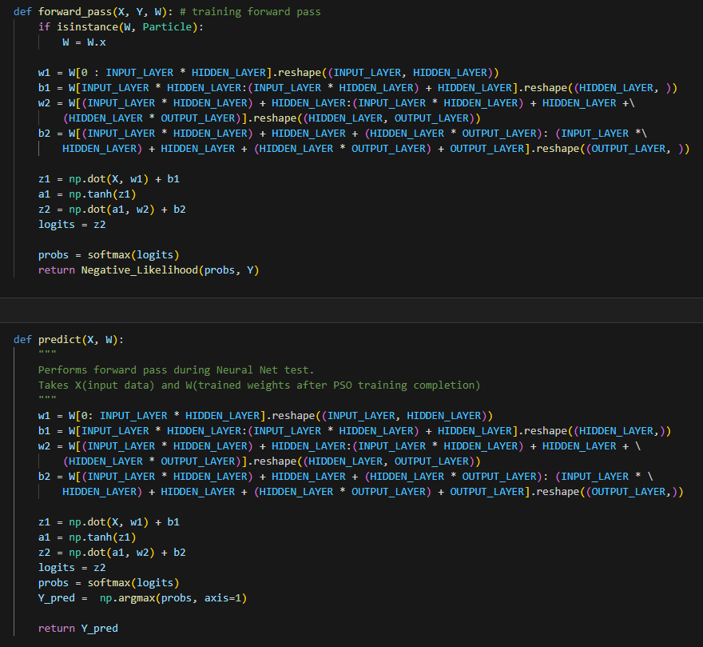
Particle Swarm Optimization in training Artificial Neural Network
Breakdown of the model
Forth, compile the forward_pass and predict function
Forward_pass is used during training phase while predict function is used during testing to make predictions based on trained weights

Slide 33
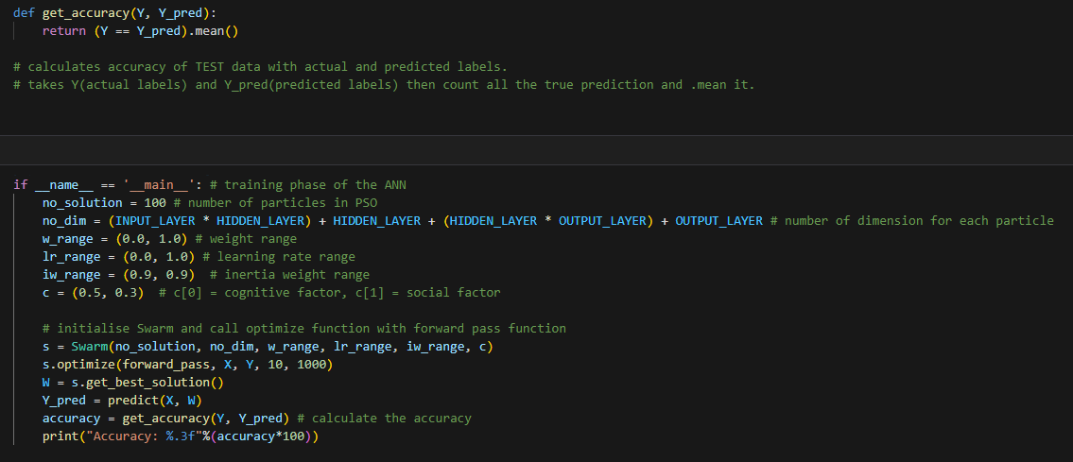
Particle Swarm Optimization in training Artificial Neural Network
Breakdown of the model
Fifth, compile the get_accuracy function and then initialise the Swarm and call the optimize function with the forward pass. This is the training phase of the ANN using PSO. After that, the prediction is made to get the accuracy results.

Slide 34
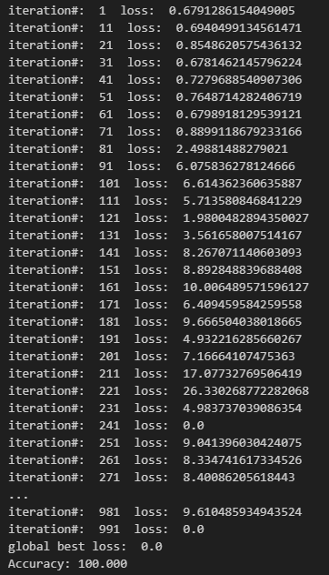
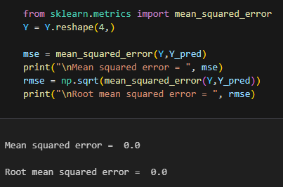
Particle Swarm Optimization in training Artificial Neural Network
Breakdown of the model
The model has a frequency of 10 for every iteration process and a total of 1000 iterations are running in the optimization process.
Then, the MSE and RMSE is calculated

Slide 35
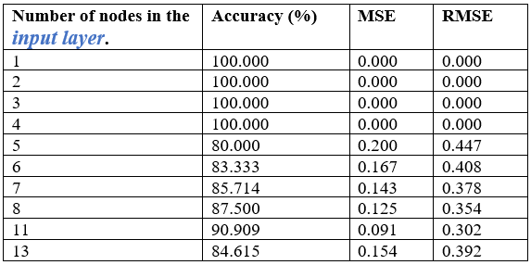
Particle Swarm Optimization in training Artificial Neural Network
Breakdown of the model
Results of experiments with different number of input features.

Slide 36
Particle Swarm Optimization in training Artificial Neural Network
Purpose of this model
To observe and evaluate the functions of swarm intelligence algorithm in training artificial neural network.
Experimenting what are the outputs when a labelled dataset is used as the input instead of an unlabelled dataset.
The model which compliments the topic of this capstone project.

Slide 37
Thank you

